Slide 1
Accessibility in Web Development
What you need to know

Slide 2
In this presentation
What is accessibility and why is it important?
The importance of good HTML Semantics in accessible development
WCAG recommendations as standards
The Accessibility Tree model
Extending the DOM/Accessibility Tree with ARIA attributes

Slide 3
What is “Accessibility”?
When someone describes a site as "accessible", they mean that any user can use all its features and content, regardless of how the user accesses the web — even and especially users with physical or mental impairments.
Source: https://developer.mozilla.org/en-US/docs/Learn/Accessibility
Ensuring sites are usable for people with disabilities
E.g. visual, hearing, mobility, cognitive impairments
Not limited to disability
Also consider people on mobile devices, or slow connections

Slide 4
Why is accessible design important?
Making website usable by as many people as possible
i.e. increasing their reach
Legal requirement in UK public sector
Discrimination laws may apply in other sectors
Accessible sites are more readily usable by anyone
Consistent/friendly UI behaviour (e.g. modals/menus)
Consistent/clean structure of DOM (easier to maintain)
Ability to turn of potentially annoying features

Slide 5
It starts with HTML Semantics
Whether a user:
requires assistive technology;
has limited mobility;
cognitive impairment or not;
or none of the above…
… good HTML Semantics address the bulk of accessibility requirements.

Slide 6
HTML Semantics – Some basic pointers
Define regions semantically
<header>, <main>, <footer>
<section>, <article>
Maintain a logical heading structure
E.g. Nested headers - h1>h2+h2>h3
Use correct elements
E.g. use <a href=“”>or <button> rather than a styled <span>
Don’t try to reinvent existing controls
Good HTML Semantics will meet user expectations

Slide 7
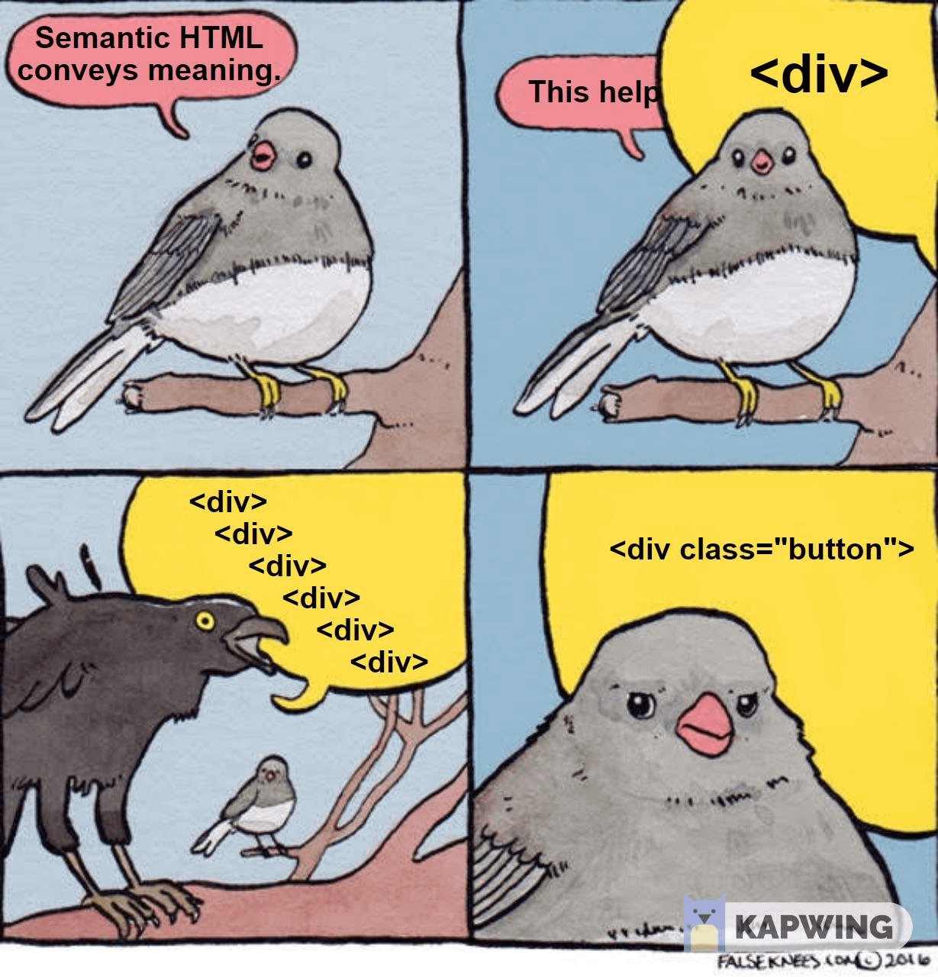

Slide 8
The WCAG Standard
Web Content Accessibility Guidelines
Current version is 2.2
Outlines rules to three different standards:
A, AA & AAA
WCAG 2.2 is a legal requirement for public sector
Official standards doc: https://www.w3.org/TR/WCAG22/
A nice visual summary:

Slide 9
Example WCAG Standards and Solutions
1.1.1 Text Alternatives for non-text content
E.g. alt text in img elements
1.4.3 Minimum Contrast
i.e. minimum contrast ratio of text
1.4.4 Resize Text
i.e. don’t prevent users from resizing text
2.4.1 – Bypass Blocks
The “Skip to Content Button”
e.g. https://www.w3.org/

Slide 10
The Accessibility Tree
The Accessibility Tree
Built by your browser, from the DOM
Contains info on each node’s role, how it’s labelled, whether it’s focusable etc
Used by accessibility tools like screen readers and summary tools to interpret the page
Can be explored in browser dev tools
Generally defined from HTML semantics and attributes

Slide 11
WAI-ARIA
A set of roles and attributes for HTML which help define parts of the accessibility tree
https://developer.mozilla.org/en-US/docs/Web/Accessibility/ARIA
e.g. aria-label and aria-labelledby
e.g. aria-hidden
e.g. with roles: https://aria-playground.vercel.app/tabs
Concerns:
ARIA is best used as a backup plan
Good HTML semantics is better than patching poor semantics with ARIA
No ARIA is better than bad ARIA

Slide 12
General Tips and Principles
Get to know the accessibility aids you’re developing to support
Install a screen-reader and use it to browse your site
Different tools may interpret/implement standards differently
If possible, test your work with multiple screen-readers
Test your work in multiple browsers
Accessibility should be baked in as a definition of done
Accessibility issues are not technical debt!

Slide 13
Useful Development/Test Tools
Screen-readers
VoiceOver pre-installed with MacOS
Windows has Narrator, but a better free screen-reader is NVDA
Automated Testing tools
pa11y and pa11y-ci: npm packages
Lighthouse and axe DevTools: browser extensions
ONLY 30% OF ACCESSIBILTY DEFECTS CAN BE AUTOMATICALLY DETECTED

Slide 14
Useful Resources
Léonie Watson on developing for accessibility
WCAG 2.2 docs and summarised by the the WCAG 2.2 Graphic
W3C Accessibility Advice for Developers
Accessibility Developer Guide
Based on 2.1 but still valid
an excellent resource covering the concepts discussed here, with practical examples and more
MDN Aria Docs
#accessibility-design on BJSS Slack

Slide 15
In summary
Accessibility broadens website reach and makes UI more usable for everyone
HTML Semantics resolves most accessibility issues
ARIA can enhance this but should be used with care
WCAG 2.2 guidelines are worth reviewing, at least to A and preferably AA standard

